Slide 1
CSCI 3412 Algorithm
Module 8: Sorting in Linear time

Slide 2

Last Lectures We’ve learned
Bogosort
Selecting K^{th} smallest element
Quicksort
Randomized Algorithm
Data arrangement (randomness) matters
Usually, they perform best if the input data are randomized

Slide 3
Today
Lower bound for comparison-based sorting
Other sorting algorithm (Non-comparison-based sorting)
Spaghetti (stick) sort
Counting sort
Radix sort
Bucket sort

Slide 4

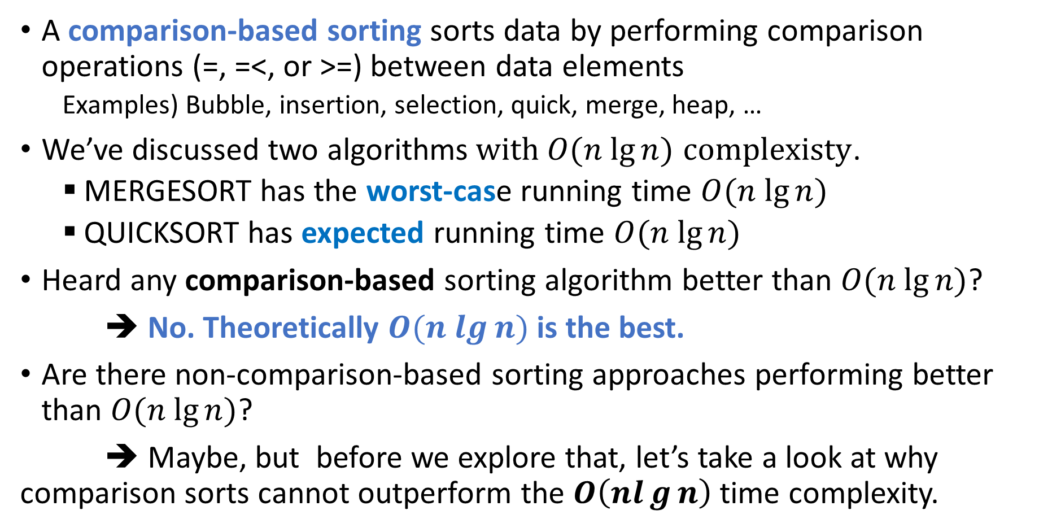
Comparison-based Sorting: Efficiency and Limits
A comparison-based sorting sorts data by performing comparison operations (=, =<, or >=) between data elements
Examples) Bubble, insertion, selection, quick, merge, heap, …
We’ve discussed two algorithms$with O(n lg⁡n)$ $complexisty$.
MERGESORT has the worst-case running time $O(n lg⁡n)$
QUICKSORT has expected running time $O(n lg⁡n)$
Heard any comparison-based sorting algorithm better than $O(n lg⁡n)$?
➔ No. Theoretically $O(n lg⁡n)$ is the best.
Are there non-comparison-based sorting approaches performing better than $O(n lg⁡n)$?
➔ Maybe, but before we explore that, let’s take a look at why comparison sorts cannot outperform the $O\left(nlg{n}\right)$time complexity.

Slide 5
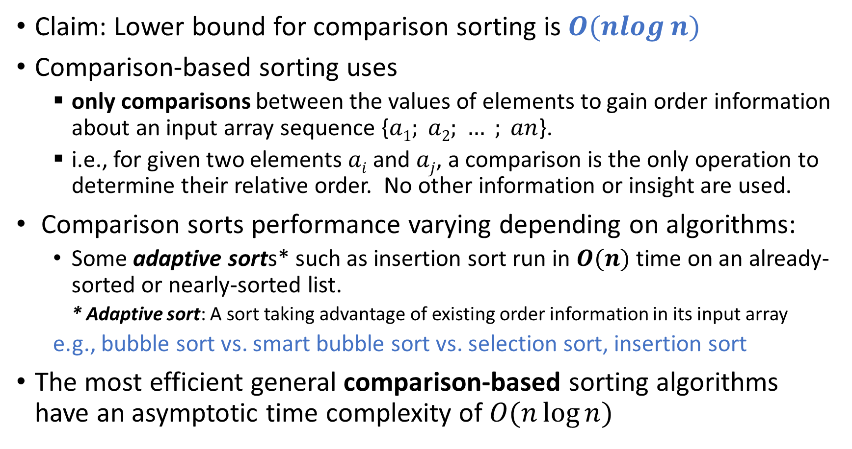
Lower bound for Comparison-based Sorting
Claim: Lower bound for comparison sorting is $O(nlog⁡n)$
Comparison-based sorting uses
only comparisons between the values of elements to gain order information about an input array sequence {$a1; a2; … ; an$}.
i.e., for given two elements $ai$ and $aj$, a comparison is the only operation to determine their relative order. No other information or insight are used.
Comparison sorts performance varying depending on algorithms:
Some adaptive sorts* such as insertion sort run in $O(n)$ time on an already-sorted or nearly-sorted list.
* Adaptive sort: A sort taking advantage of existing order information in its input array
e.g., bubble sort vs. smart bubble sort vs. selection sort, insertion sort
The most efficient general comparison-based sorting algorithms have an asymptotic time complexity of$O(n\log{n})$

Slide 6

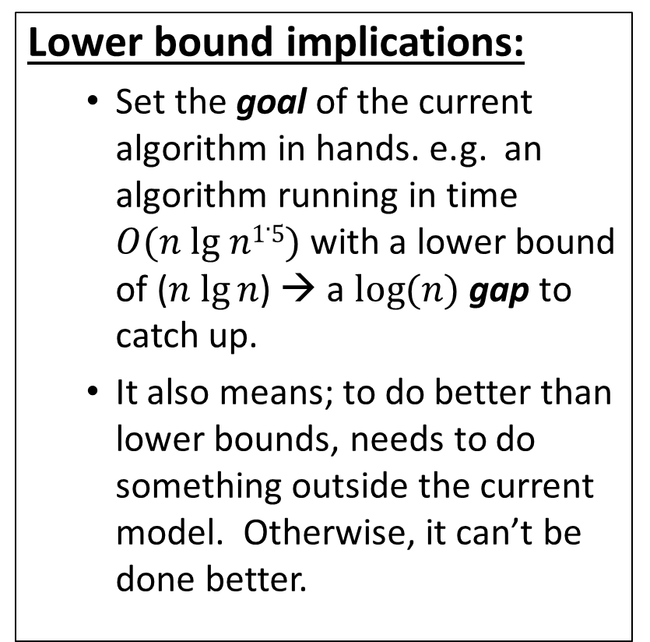
Lower Bound for Sorting
Lower bound implications:
Set the goal of the current algorithm in hands. e.g. an algorithm running in time $O(n lg n1.5)$ with a lower bound of ($n lg⁡n$) → a $log⁡(n)$ gap to catch up.
It also means; to do better than lower bounds, needs to do something outside the current model. Otherwise, it can’t be done better.
Theorem:
In the worst-case scenario, any deterministic comparison-based sorting algorithm is required to perform at least $Ω(n log⁡n)$comparisons to sort $n$ elements.
Specifically, for all $n ≥ 2$, there exists an input array of size $n$ such that the sorting algorithm will execute at least $log2(n!) = n log⁡n$comparisons out of total of $n!$ permutations to sort the input array.

Slide 7
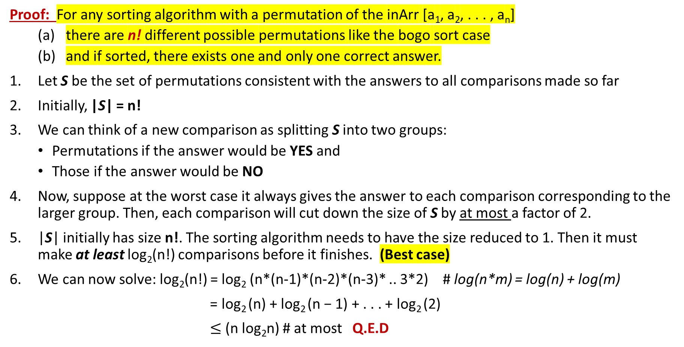
Lower bound for Comparison-based Sorting
Proof: For any sorting algorithm with a permutation of the inArr [a₁, a₂, . . . , a_{n}]
there are n! different possible permutations like the bogo sort case
and if sorted, there exists one and only one correct answer.
Let S be the set of permutations consistent with the answers to all comparisons made so far
Initially, |S| = n!
We can think of a new comparison as splitting S into two groups:
Permutations if the answer would be YES and
Those if the answer would be NO
Now, suppose at the worst case it always gives the answer to each comparison corresponding to the larger group. Then, each comparison will cut down the size of S by at most a factor of 2.
|S| initially has size n!. The sorting algorithm needs to have the size reduced to 1. Then it must make at least log₂(n!) comparisons before it finishes. (Best case)
We can now solve: log₂(n!) = log₂ (n*(n-1)*(n-2)*(n-3)* .. 3*2) # log(n*m) = log(n) + log(m)
= log₂ (n) + log₂ (n − 1) + . . . + log₂ (2)
$≤$(n log₂n) # at most Q.E.D

Slide 8
Decision Tree
A statement: in all such trees, the longest path is at least log(n)
?
YES
NO
This is a binary tree with at least _____ leaves.
The shallowest tree with n! leaves is the completely balanced one, which has depth ______.
So in all such trees, the longest path is at least log(n!), which is the best scenario.
?
?
n!
YES
NO
YES
NO
?
?
?
?
log(n!)
Each leaf of this tree represents a possible ordering (not sorting) of the items: If reached a leaf, a specific set of ordering has been completed
Mathematically speaking:
n! is about (n/e)^{n} (Stirling’s formula). log(n!) is about n log(n/e) = Ω(n log(n))
Conclusion: the longest path has length Ω(n log(n)).

Slide 9
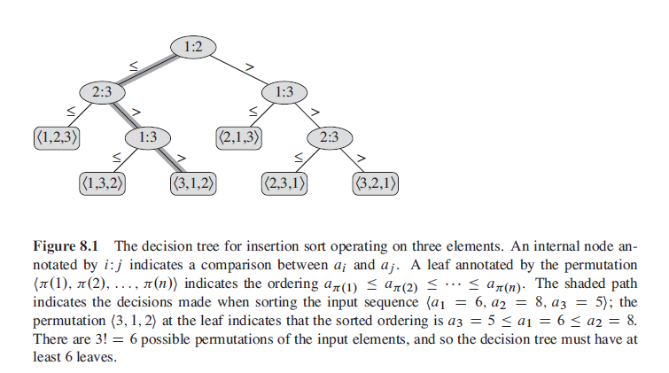
CLRS: Page 192 : Decision Tree
3! = 3 x 2 x 1 = 6

Slide 10

Now what???
Merge sort and Quicksort are as optimal as they can be in terms of comparison-based sorting efficiency.
This is one of good reasons of lower bound analysis – we know how low we can possibly go.
Well … are we done, then? No!
Can we do it any better in other ways?
➔ Can we do any better applying a sorting approach other than comparison-based algorithm?

Slide 11
Non-Comparison Sorting
Zigsaw
Spaghetti
Counting
Radix
Bucket

Slide 12

Sorting beyond Comparison-based mode - Zigsaw Puzzle Sort -
Let’s take advantage of special property of the input data.
Example) Zigsaw puzzle sorting strategies:
Flip all pieces upwards
Find all the edge pieces (Using data outlook in stead of the data value (shape))
Sort by color
Separate special pieces (distinguishing parts)

Slide 13
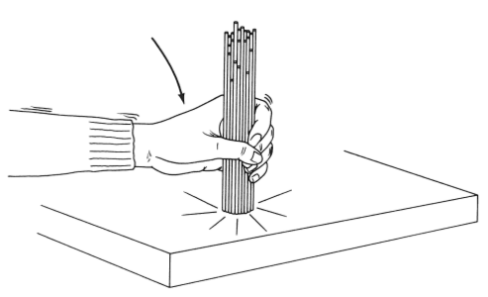
A Non-comparison-based Sorting: Spaghetti Sort
More of a conceptual experiment rather than a practical algorithm
Analog algorithm for sorting a sequence of items
Sorts a sequence of items requiring O(n) stack space in a stable manner.
Algorithm – using uncooked rods of spaghetti for illustration
For each natural number x in the list, obtain a rod of length x.
Take them loosely in your fist and lower them to the table, so that they all stand upright, resting on the table surface.
Now, for each rod, lower your other hand from above until it meets with a rod—this one is clearly the longest. (contact-and-removal operation)
Remove this rod and insert it into the front of the (initially empty) output list
Repeat until all rods have been removed.
A parallel processing would be a good fit. Where?
Time efficiency? O(n)
No comparisons among input data themselves

Slide 14

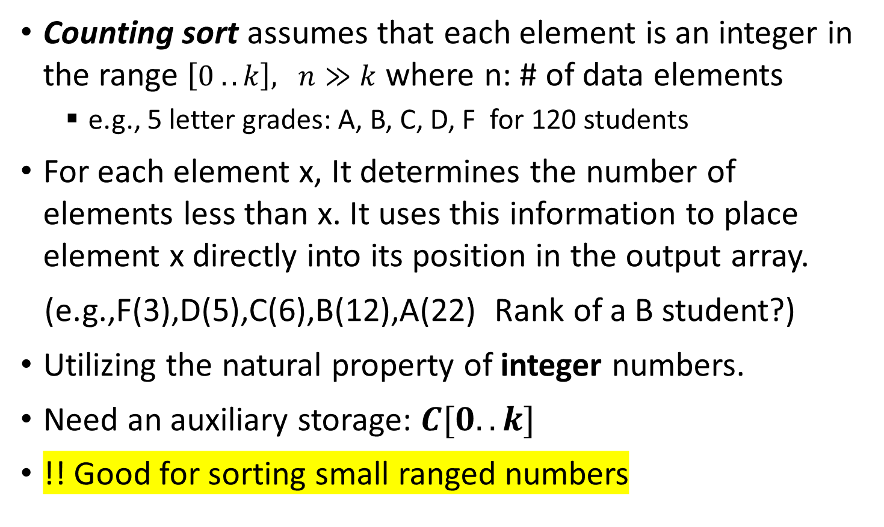
Counting Sort
Counting sort assumes that each element is an integer in the range $\left[0 .. k\right], n≫k$ where n: # of data elements
e.g., 5 letter grades: A, B, C, D, F for 120 students
For each element x, It determines the number of elements less than x. It uses this information to place element x directly into its position in the output array.
(e.g.,F(3),D(5),C(6),B(12),A(22) Rank of a B student?)
Utilizing the natural property of integer numbers.
Need an auxiliary storage: $C[0..k]$
!! Good for sorting small ranged numbers

Slide 15
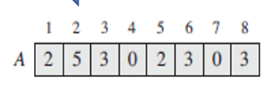
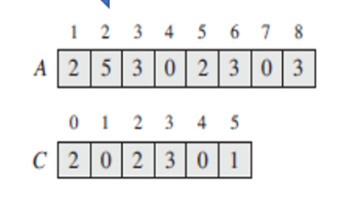
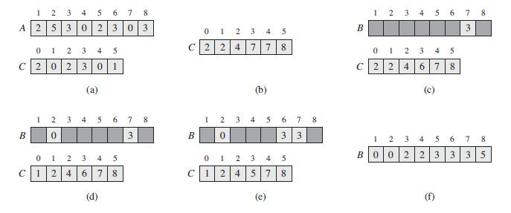
Counting Sort: How does it wok?
0. Input Array:
1. Scan & count:
3. Sorting:
Sorting order
2. Insert into the position
1. Lookup
2. Counting
3. Subtract by 1

Slide 16
Counting Sort: Time Efficiency
Time Efficiency:
O(n) for scanning and counting to build C[0..k]
O(k) for updating counter
O(n) for scanning and sorting
O(2n + k ) but O(n), usually n >> k
Detail: CLRS: Page: 195

Slide 17
Counting sort Example (Sorting a string alphabetically)
def countSort(inArr):
output = [0 for i in range(len(inArr))]
C = [0 for i in range(256)]
# Store the count of each character
for i in inArr:
C[ord(i)] += 1
# C[i] contains actual position of this character
for i in range(256):
C[i] += C[i-1]
# Build the output character array
for i in range(len(inArr)):
output[C[ord(inArr[i])]-1] = inArr[i]
C[ord(inArr[i])] -= 1
return output
print(countSort("UniversityOfColoradoAtDenver"))

Slide 18
Counting Sort: why not comparison-based?
Why is counting sort not a comparison-based sorting algorithm?
Counting sort gains sorting order by means other than directly comparing 2 keys
Sorting is accomplished by finding its position in the sequence of values
Would the algorithm be correct if we started at the beginning of the array? Why do we start from the end of the array?
For Stable sorting
Maintains the relative order of elements with equal keys (values); i.e. keys with same value appear in same order in output as they did in input array
Why is stable sorting important?
When the data is sorted multiple times on different keys (fields) and the key is truly a key to a much larger underlying data structure

Slide 19
Sorting Integers: Counting Sort Issues
What if the key values are in a range from 1 to n² ?
Counting sort is no good because it takes O(2n + n²). (k = n²)
Worse than comparison-based sorting.
How can we sort such an array in linear time?
e.g., sorting 100 K data elements ranging 0 – 999M like SSN
Can we do better? Radix Sort may help.
Example: For 10 numbers ranging 1 .. 100, you need to set up and process 100 buckets for 10 numbers. (n: 10, n² = 100) ➔ O(n²)

Slide 20
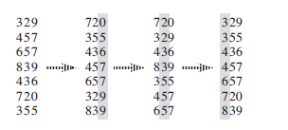
Sorting Integers: Radix Sort
Stable sorting
How IBM made its money.
Punch card readers for census tabulation in early 1900’s.
Card sorters, worked on one column at a time.
It is the algorithm for using the machine that extends the
technique to multi-column sorting.
Radix (base): Binary: [0,1], Octal: [0..7], Decimal [0..9], Hex [0 .. F]
Algorithm: Its fundamental operation of sorting based on the radix or base of the numbers being sorted
Sorting decimal numbers in descending order —counterintuitively—by sorting on the least significant digit first.
Then combines the cards into a single deck stacking them increasing order.
Then it sorts the entire deck again on the second-least significant digit and recombines the deck in a like manner.
The process continues until the cards have been sorted on all d digits. (Total repeating time: d)
Question: What if sorting by most significant digit first?

Slide 21
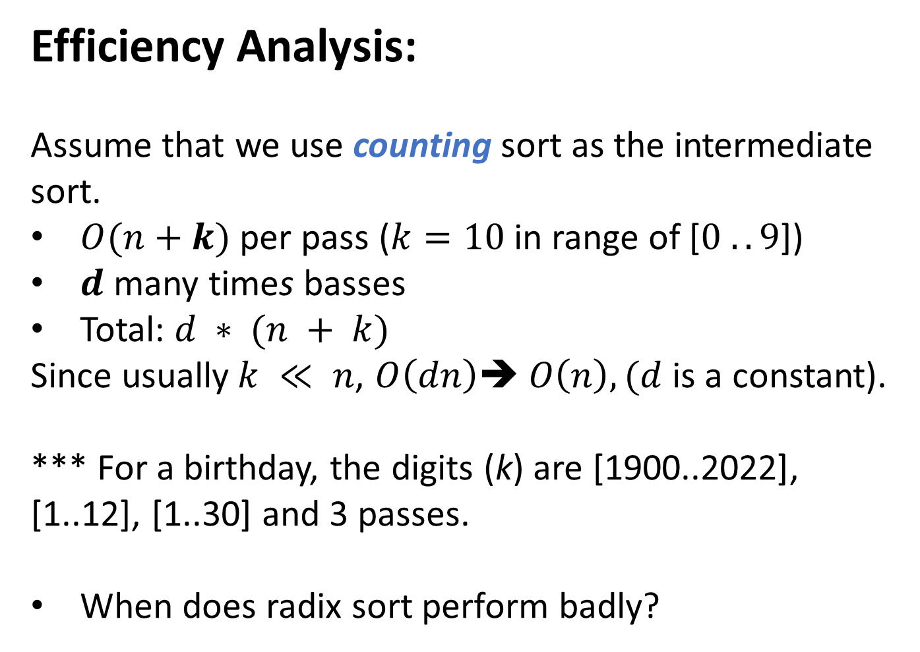
Sorting Integers: Radix Sort
Efficiency Analysis:
Assume that we use counting sort as the intermediate sort.
$O(n+k)$per pass ($k=10$in range of [$0 . . 9$])
$d$ many times basses
Total: $d ∗ (n + k)$
Since usually$k ≪ n$, $O\left(dn\right)➔ O\left(n\right),(d$ is a constant).
*** For a birthday, the digits (k) are [1900..2022], [1..12], [1..30] and 3 passes.
When does radix sort perform badly?

Slide 22

RadixSort Correctness Proof
Argument via loop invariant (i.e., induction).
Loop Invariant:
After the k^{th} iteration, the array is sorted by the first k least-significant digits.
Base case:
Sorted by 0 least-significant digits means not sorted.
Inductive step:
(You fill in…)
Termination (k = d):
After the d’th iteration, the array is sorted by the d least-significant digits and d is the largest. So, it’s sorted.
*** Intermediate sorting must be a stable sort.

Slide 23
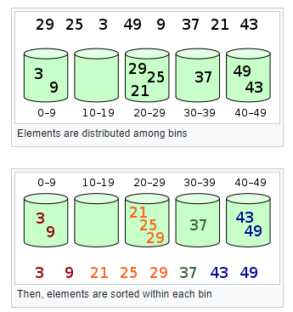
Sorting Integers: Bucket Sort
- Counting and radix sorts works well when the input array consists of integers in a small range.
When the input array is uniformly & independently distributed over large span ➔Bucket sort
Bucket sort divides the global interval into the given k equal-sized subintervals, or buckets.
Then, evenly distributes the n numbers in the input array into the buckets.
If the elements are distributed evenly and the number of buckets is proportional to the number of elements . The best case is when the number of elements per bucket is constant
Use insertion sort to sort each input array in a bucket
Special usage: You can use it as an external sorting algorithm especially if you need to sort a list that is so huge you can’t fit it into memory.

Slide 24
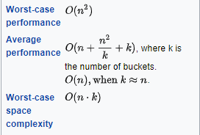
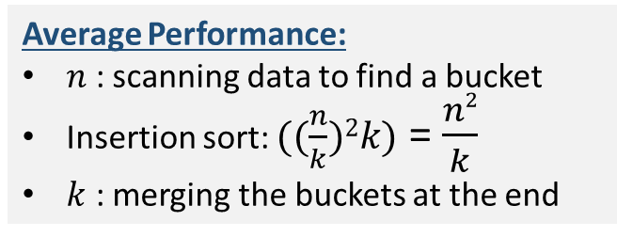
Bucket Sort: Efficiency
Different Conditions: average: O(n+k)
k : number of buckets
Best-case
Average Performance:
$n$ : scanning data to find a bucket
Insertion sort: $((\frac{n}{k})2k)$ = $\frac{n2}{k}$
$k$ : merging the buckets at the end
- Bucket sort is a generalization of counting sort where each bucket range (size) is 1.
- If there are two buckets, it’s similar to a quick sort partitioning. Why?
Notes:
O(n2) : when all elements are in one bucket and use insertion sort to sort
O(n) : when bucket size is 1 (== counting sort)
O(n + k) : when k >> n (like counting sort) why k? You need to merge all the buckets together as a final step.

Slide 25
Bucket Sort: Python code
def bucketSort(theList):
bucket = []
slot_number = (max(theList) - min(theList)+1)//len(theList)+1 # your own slot size
for i in range(slot_number): # creating slot_number buckets
bucket.append([])
for j in theList:
index_b = (j - min(theList) + 1)// len(theList)
bucket[index_b].append(j)
for i in range(slot_number):
bucket[i] = sorted(bucket[i]) # you may call your own simple sort()
k = 0
for i in range(slot_number):
# theList.extend(bucket[i]) or
for j in range(len(bucket[i])):
theList[k] = bucket[i][j]
k += 1
return theList
[Sharing idea: simplistic bucket sort code]

Slide 26
Bucket Sort: Analysis
In general, implement the buckets as linked lists. Why? They are first-in, first-out.
Some issues:
Need to know what bucket to put something in.
Need to know what input values might show up ahead of time to evenly distribute the data across the buckets.
2
125
1300
2⁴⁵
500
1000000
1
If the input array is NOT drawn from a uniform distribution, all bets are off (performance-wise, but the algorithm is still correct).

Slide 27
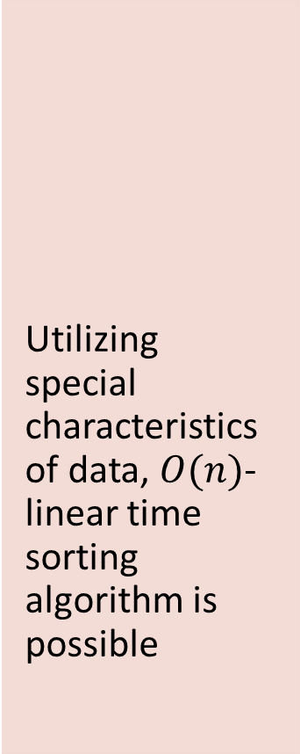
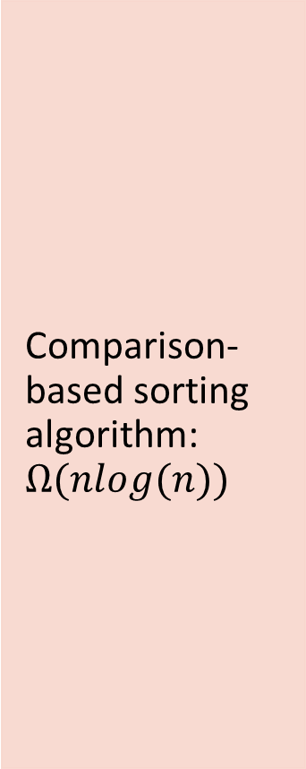
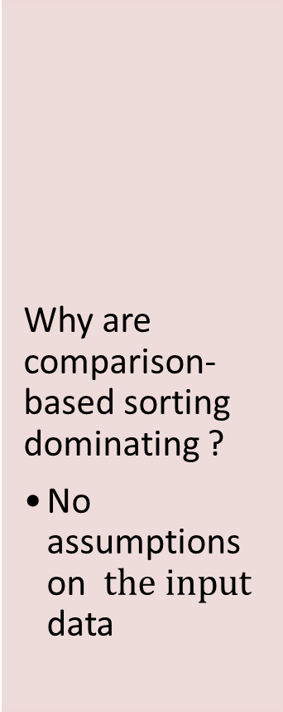
In summary:
Comparison-based sorting algorithm: $Ω(nlog(n))$
Utilizing special characteristics of data, $O(n)$-linear time sorting algorithm is possible
Why are comparison-based sorting dominating ?
No assumptions on $the input$ data
In general, the time complexity of a sorting algorithm depends on the model of computation
How good a model of computation is up for discussion.
1
2
3
4
5

